Slide 1
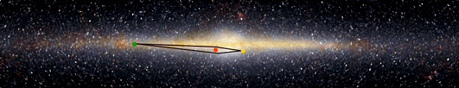
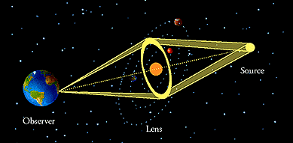
Microlensing Surveys for Small Cool Planets
Keith Horne, SUPA St Andrews
Hunting for Cool Planets near the lens stars
Cool (sub-)Earths detectable!

Slide 2

Gravitational Lensing
Strong Negative Spherical Aberration !
Observer’s View: on axis
“Einstein Ring”

Slide 3
Gravitational Lensing
Observer’s View off axis:
2 distorted images

Slide 4
Gravitational Lensing of Bulge stars
V_{rel} ~ 200 km/s
Source star near centre of Milky Way
Lens star
Tiny bend angle ~ 1 milli-arcsec
Unresolved images -> “microlensing”
~2000 cases found every year

Slide 5
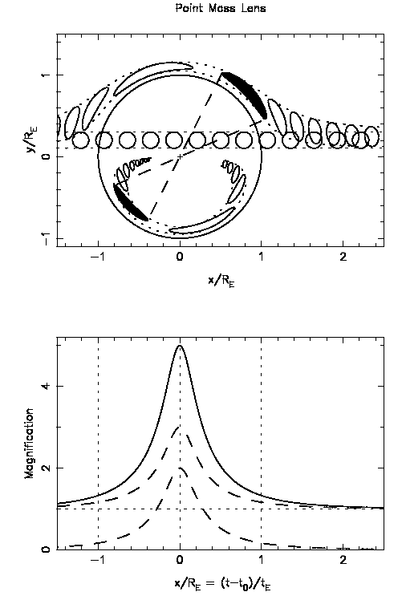
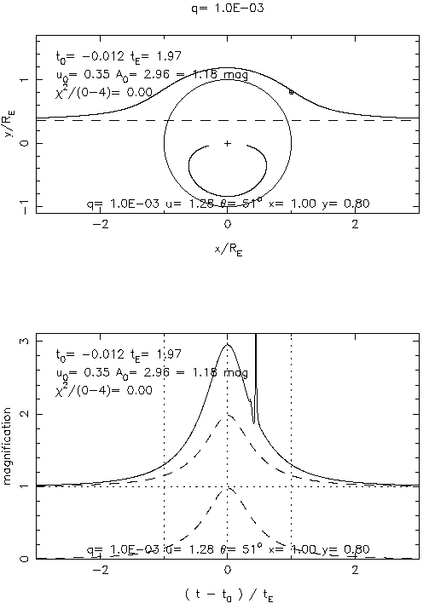
Microlensing Lightcurves reveal Planets
planet

Slide 6
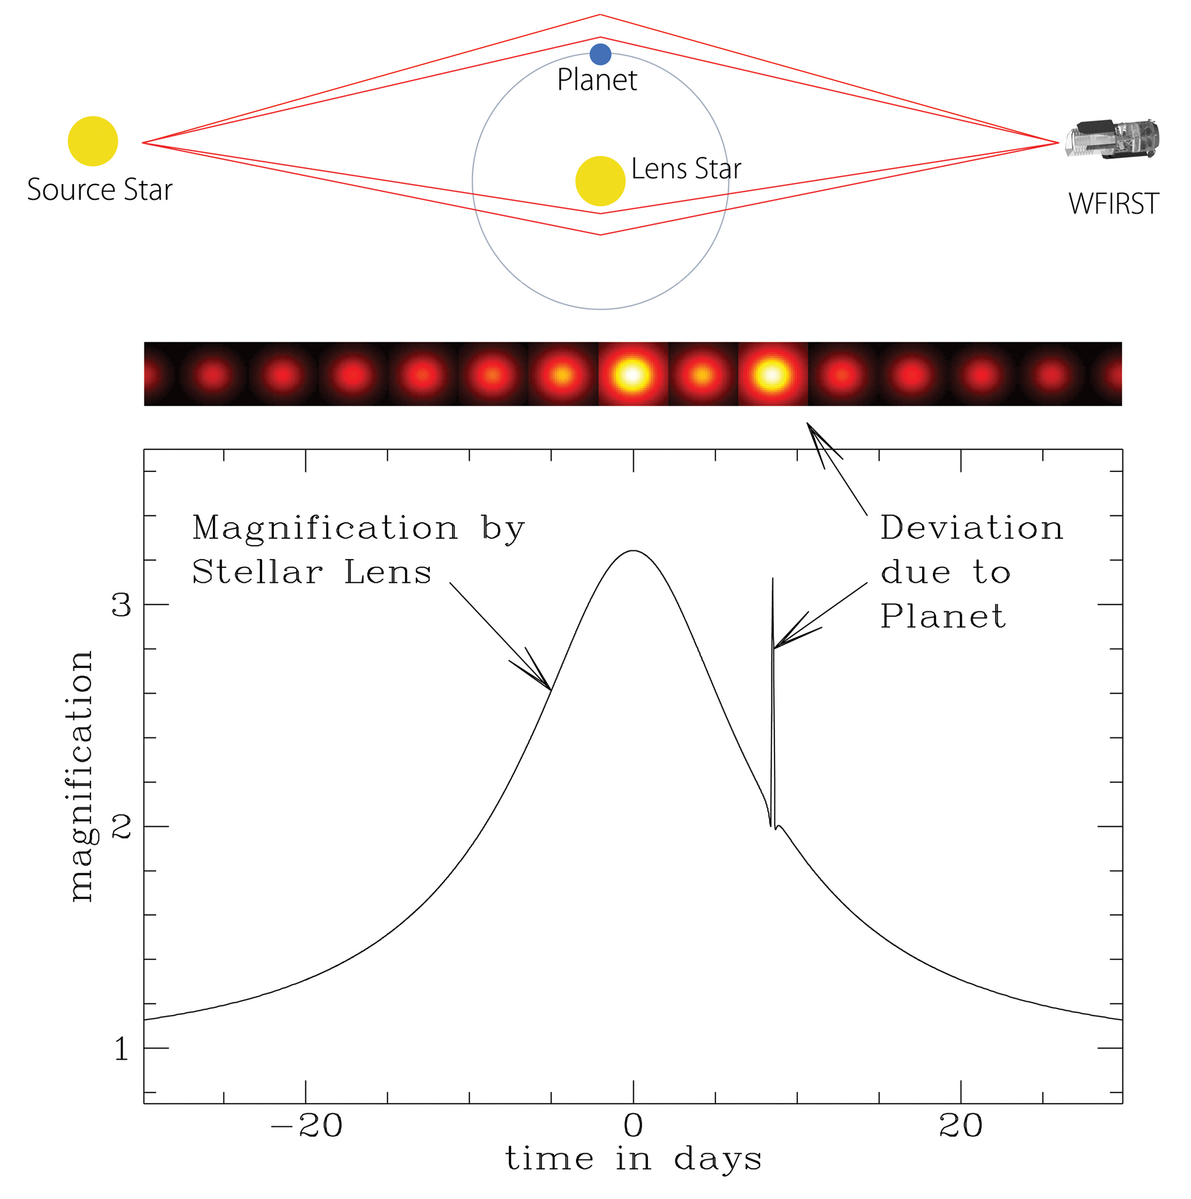
Microlens Planet Lightcurves
Large (brief) signal from small planets
Ratio of durations => mass ratio q=m/M
  Jupiters – few days
  Earths – few hours
Time offset => separation in R_{E} units

Slide 7
How we find Cool Planets :
1: find microlens events (Wide-Field Surveys)
  prob ~10⁻⁶, t_{E} ~ 10 - 100 d
  OGLE + MOA find ~2000 events / yr
2: find planet-like anomalies (Follow-up monitoring)
  Jupiters: prob ~ 15% t_{p} ~ 1 d
  Earths: prob ~ 1.5% t_{p} ~ 1 h
3: characterise planets (Real-time Anomaly alerts)
  rapid response, continuous multi-telescope monitoring
Microlens Teams: OGLE, MOA, (KMTNet) PLANET, μFUN, MiNDSTEp, RoboNet

Slide 8
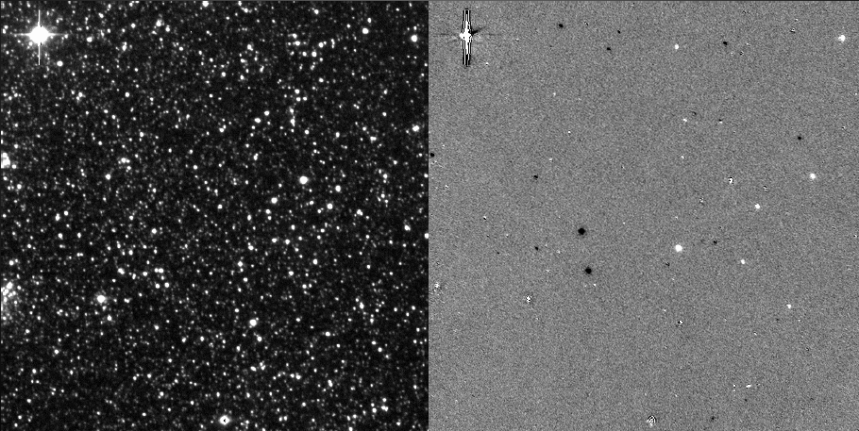
Difference Imaging of Crowded Fields
Subtracts constant stars to leave the variable ones
Key technology for microlensing

Slide 9
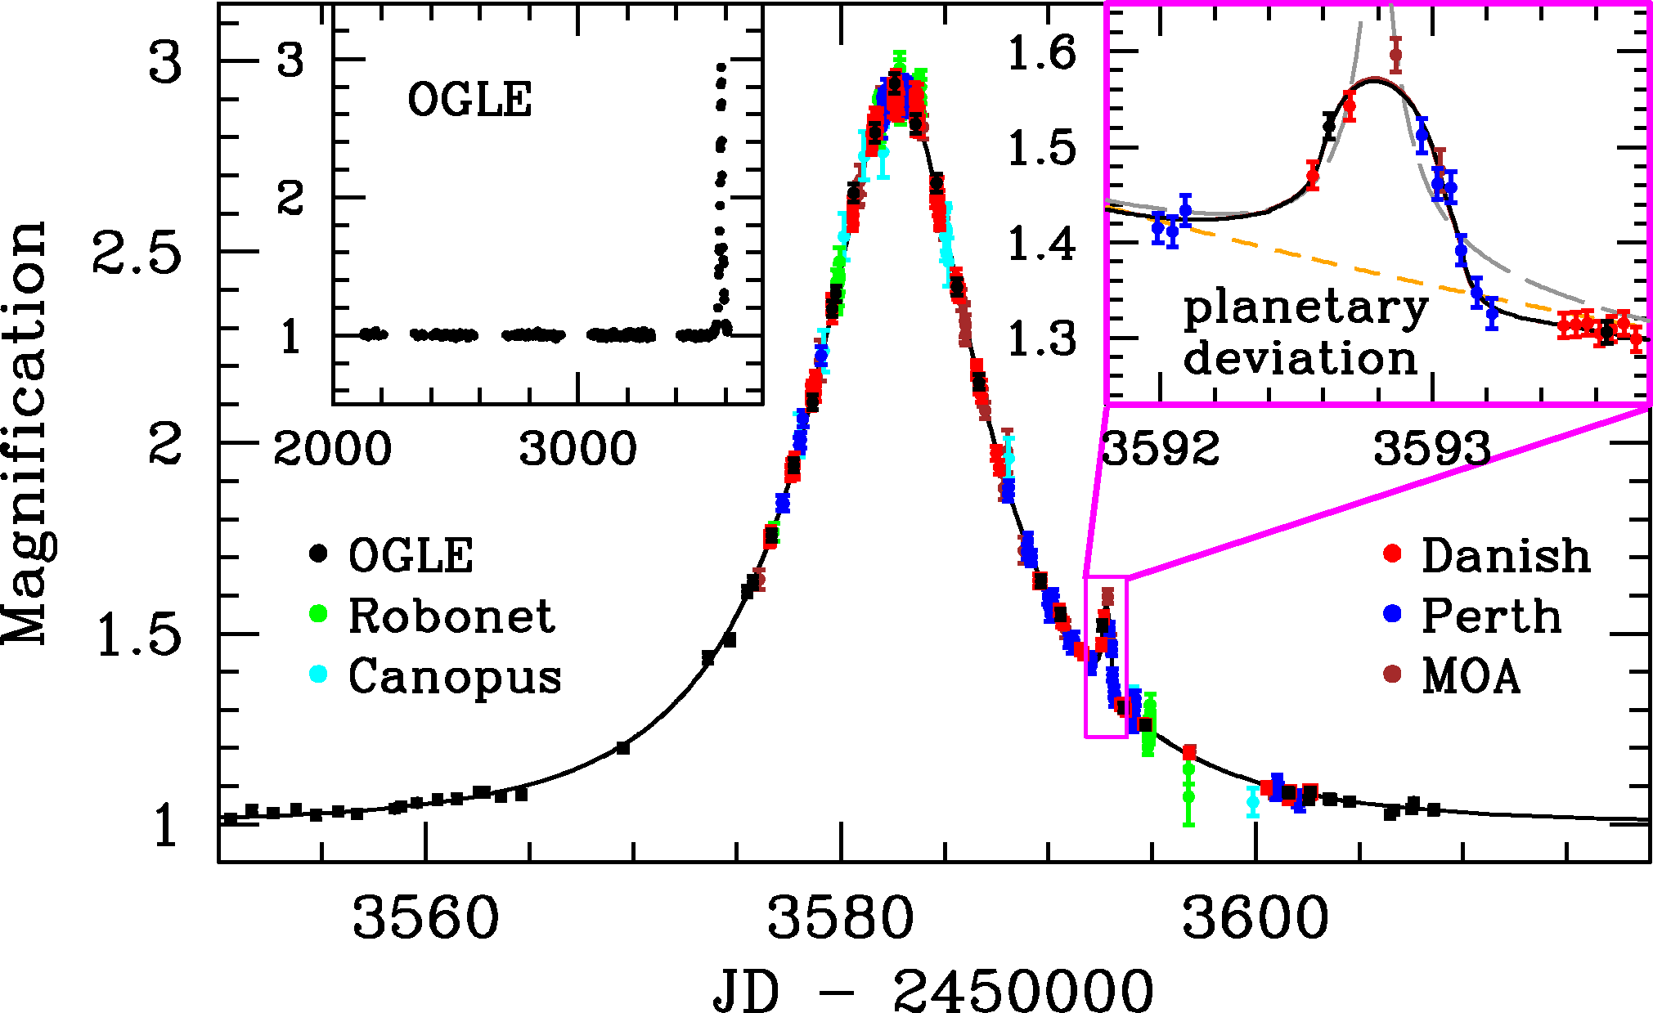
6 Earth-mass planet
OGLE-2005-BLG-390Lb
PLANET/RoboNet OGLE MOA
Use multiple telescopes around the globe (South Africa, Chile, New Zealand, Australia)
Beaulieu et al. (2006) Nature.

Slide 10
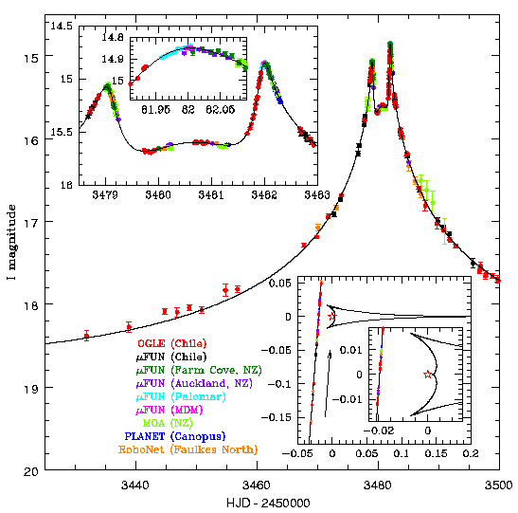
3-Jupiter mass planet
OGLE-2005-BLG-071Lb
OGLE microFUN
MOA PLANET RoboNet
Udalski et al. (2005)

Slide 11
Half-size Jupiter + Saturn analogue
OGLE-2006-BLG-109Lb,c
2 planets detected ! Orbital motion detected
m_{b}~jupiter m_{c}~saturn
OGLE microFUN
MOA PLANET RoboNet
Gaudi et al. (2008) Nature

Slide 12
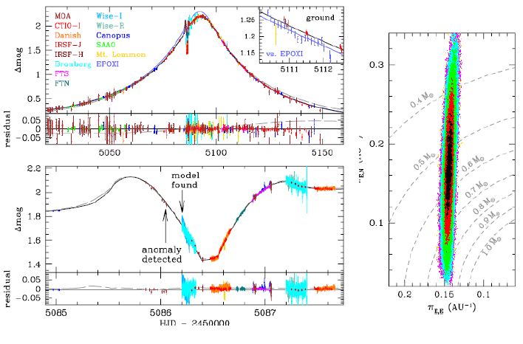
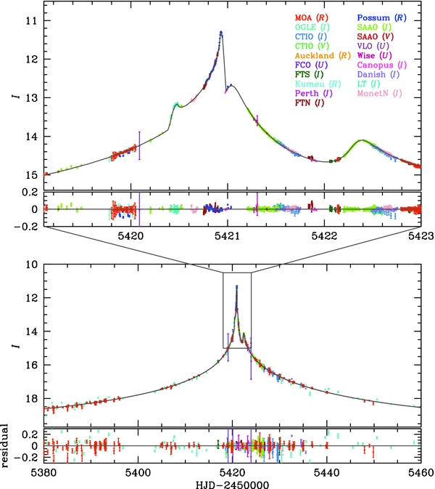
Saturn-mass planet
MOA-2009-BLG-266Lb
…. a few dozen more
5-10/year
Muraki et al. (2010) ApJ 741, 22

Slide 13
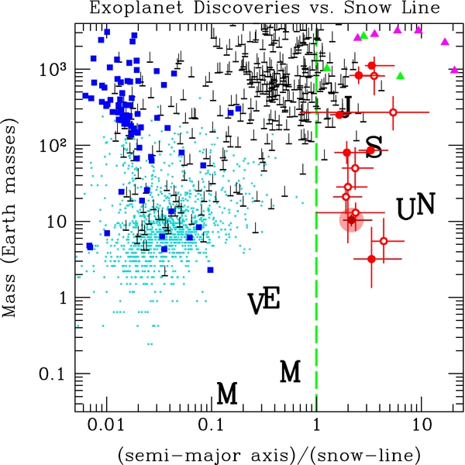
Microlensing Surveys : uniquely probe
Small Cool Planets Outside the Snow Line
M_{L} ~ 0.1-0.5 Msun
D_{L} ~ 1-8 kpc
R_{E} ~ 3-5 AU
Microlens planets typically outside the Snow Line
Sensitive to low-mass planets P(det) ~ m^{1/2}
What is the Cool Planet Mass Function ?
How fast do Cool Planets grow and migrate?
Migration line?
Gap between rock/ice cores and gas giants?

Slide 14
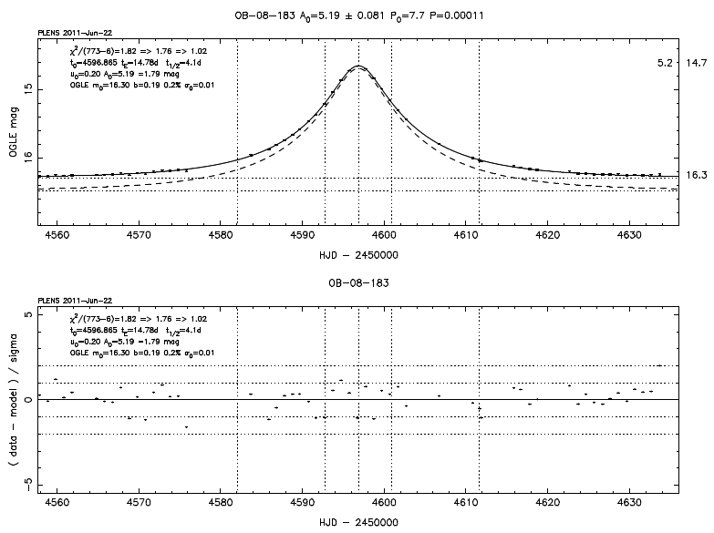
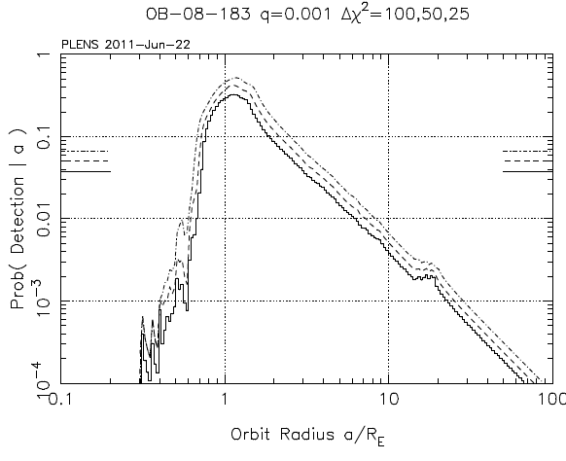
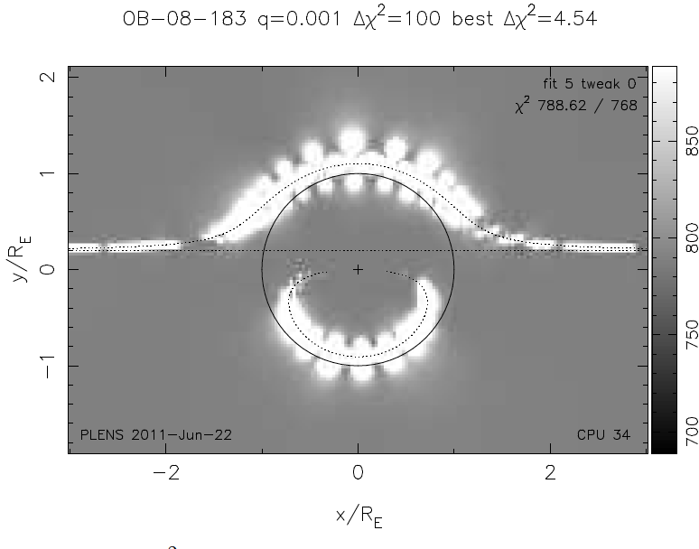
For Abundances, need Detection Probability for all events observed, with or without planets
Lightcurve Data -> Detection zones -> P( det| q, s )
q = m / M s = a / R_{E}
--------10%---
Planet detection probability
P(det|q,s)
Planet exclusion zones

Slide 15
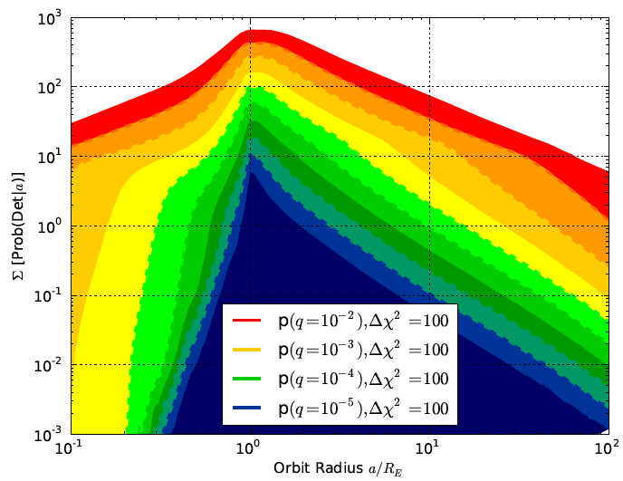
From Detections to Abundances
Planet Detections = Abundance x Sensitivity
Sensitivity = expected number of planets detected if all lens stars have 1 of the indicated type (m,a)
Power-law abundance models
Predicted Planet Catch:
3084 OGLE III events

Slide 16
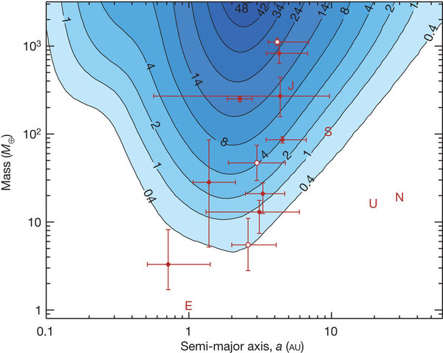
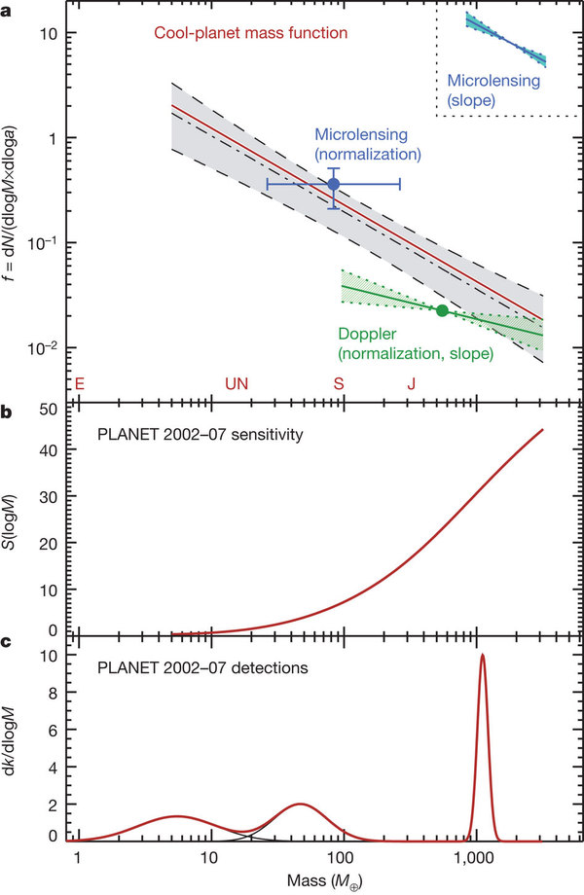
Cassan Mass Function : η(m)
Detections /Sensitivity = Abundance
η(m)
S(m,a)
S(m)
More small than large planets.
1 or more cool planets per star.
3 planet masses
Cassan et al. (2012) Nature

Slide 17
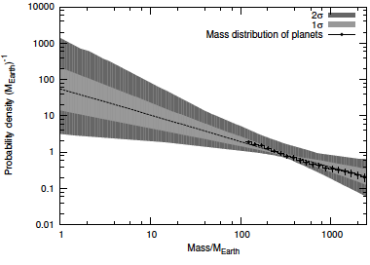
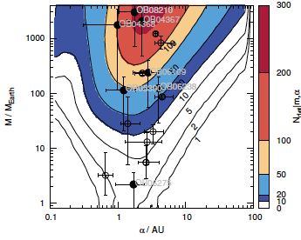
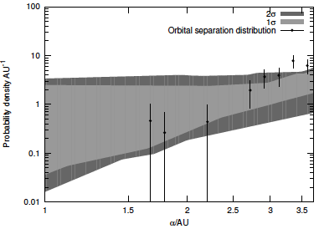
Tsapras: mass-orbit dist’n: η(m,a)
Power-law in both mass and orbit size
3084 OGLE III events
Tsapras et al. (2015?) in prep.

Slide 18

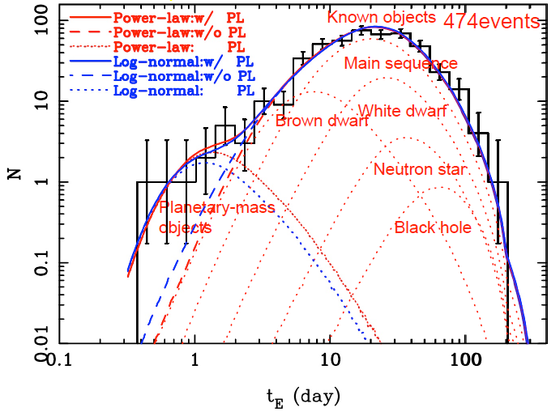
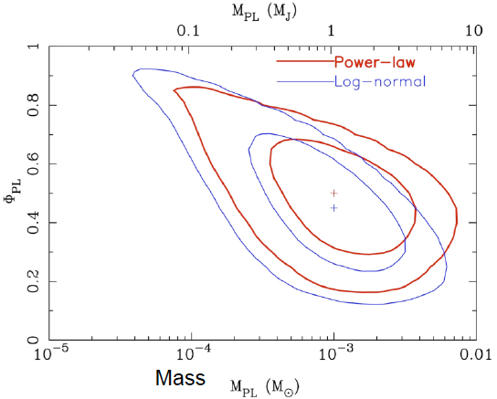
Microlensing detects “Free Floating Planets”: ( unbound or loosely bound > 10 AU)
Excess of short events (t_{E}<2d) -> small mass lenses
Sumi et al. (2011) Nature

Slide 19
Beyond Power-Laws ?
How fast do Cool Planets grow and migrate?
1. Larger numbers (statistics)
2. Accurate masses (parallax)
3. Smaller planets (sub-Earth)
1. More Telescopes: (more/smaller planets)
  LCOGT : 2013 … (9 robotic 1m scopes)
  KMTNet : 2015 … (3 wide-field 1.6m scopes)
2. Microlens Parallaxes: (accurate masses / distances)
  Spitzer 2014…, Kepler 2016
3. Angular Resolution: (sub-Earths)
  To reach main-sequence source stars
  GravityCam : Wide-Field Lucky Imager on NTT
  EUCLID / WFIRST : Wide-Field Infrared Space Imager

Slide 20
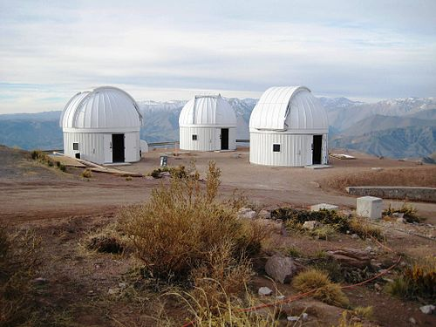
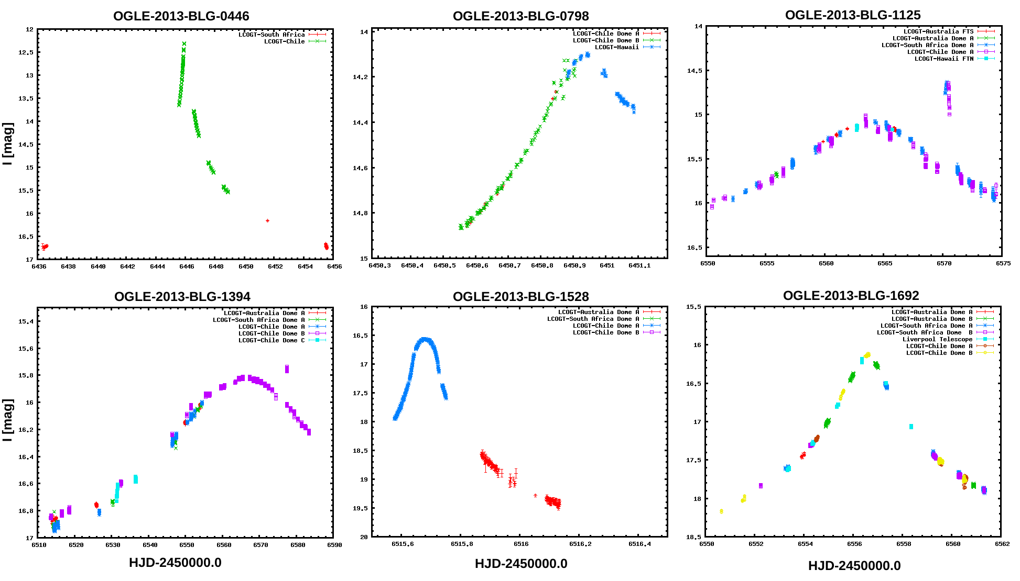
More Telescopes => more (and smaller) planets LCOGT/SUPA robotic microlens survey
LCOGT(+SUPA) robotic telescope network
  6(+3) = 9 robotic 1m scopes
  South Africa (3), Chile (3), Australia (2) and Texas (1)
+ 3 robotic 2m scopes (UK-built Liverpool + Faulkes N,S)
  In Canary Islands (LT), Hawaii (FTN), Australia (FTS)
LCOGT/SUPA Microlensing Key Project:
  2013 pilot season
  2014-16 3000h/yr
  24-hr coverage
  Follow-up best events
  Optimal observing strategy
  Real-time data reduction
  Real-time anomaly detection
  Real-time lightcurve analysis
  Systematic survey
LCOGT lightcurves 2013
LCOGT.Net = Las Cumbres Observatory Global Telescope Network

Slide 21
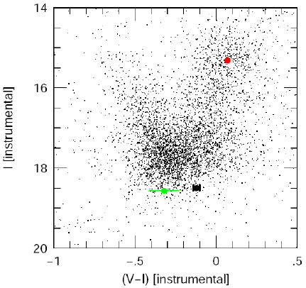
Microlens Parallax => Accurate Masses
Lightcurve analysis :
Mass ratio q = m / M
Separation s = a / R_{E}
Einstein Ring crossing time t_{E}
Source star crossing time t_{S}
2. Source star colour-magnitude :
distance D_{S}, angular size θ_{S}
θ_{E} = θ_{S} t_{E} / t_{S}
Need Parallax => D_{L}
Uncertain distance => uncertain mass : No parallax: 0.3 dex
With parallax: 30%

Slide 22
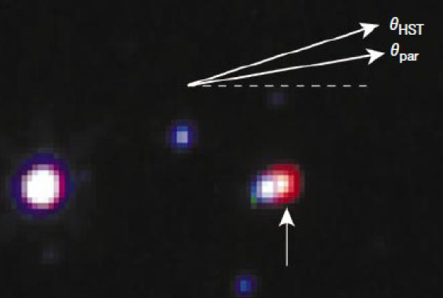
Proper motion separates the lens and source – but can be a long wait.
MACHO-LMC-005
HST data taken 6 years after the event:
Lens star colour and mag
mass M and distance D_{L}
Proper motion μ
=> R_{E} = μ D_{L} t_{E}
Alcock et al. (2001) Nature 414, 617

Slide 23
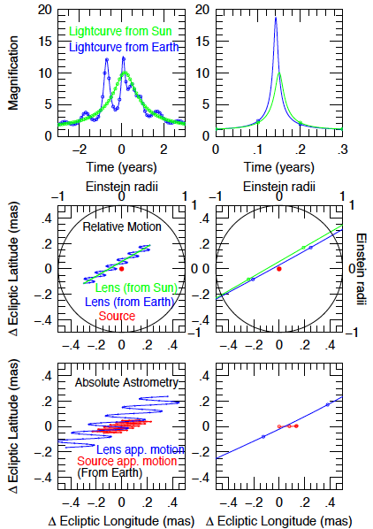
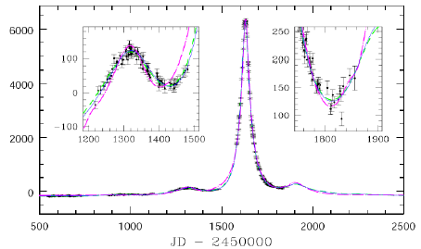
Annual Parallax due to Earth’s motion
Subtle but observable effect, best seen in longer events.

Slide 24
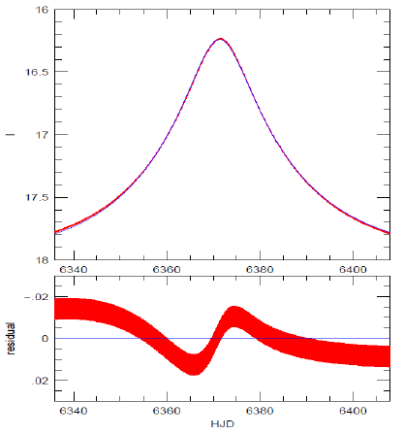
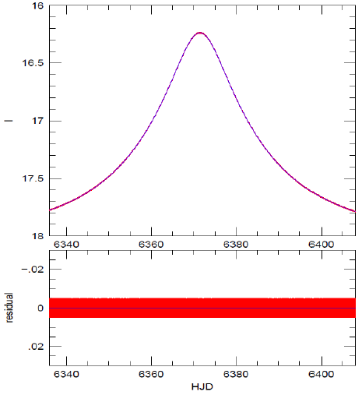
Parallax vector – parallel and perpendicular to the lens-source proper motion
Easier to measure: π_{E, ||}
Asymmetric perturbation
Harder: π_{E, ⊥}
Smaller symmetric residuals

Slide 25
Annual Parallax –> 1 component
Parallax vector ( π_{E,} π_{N} )
π_{E} measured from lightcurve asymmetry
How to measure the full parallax?
Muraki et al. (2010) ApJ 741, 22

Slide 26
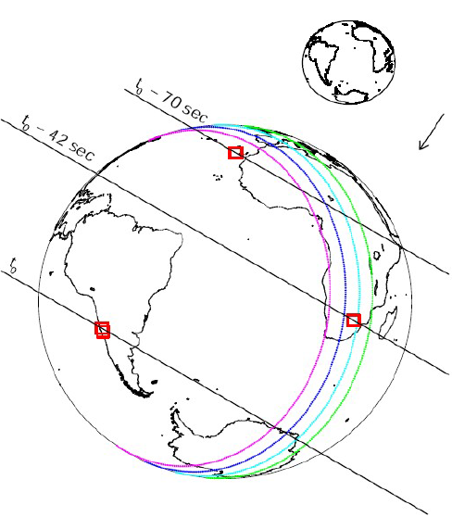
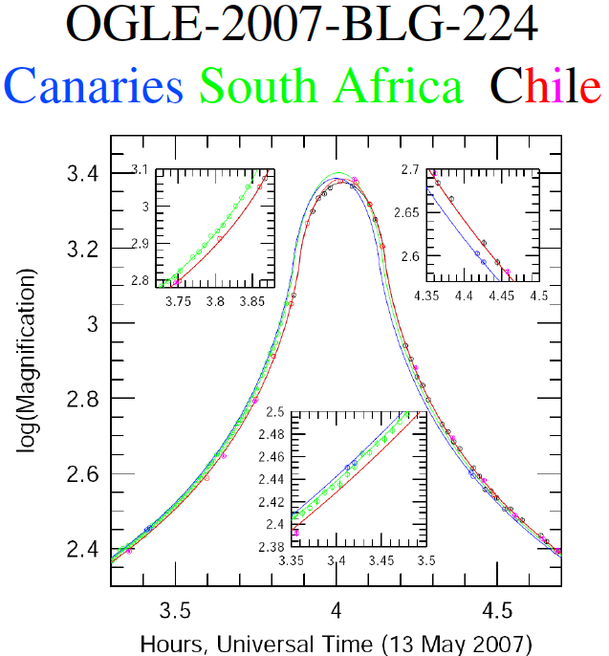
Terrestrial Parallax
Small time differences. Requires sharp lightcurve features, e.g. in very-high magnification events. Rarely observable.
~1 min across Earth
Gould et al. ApJL 2008

Slide 27
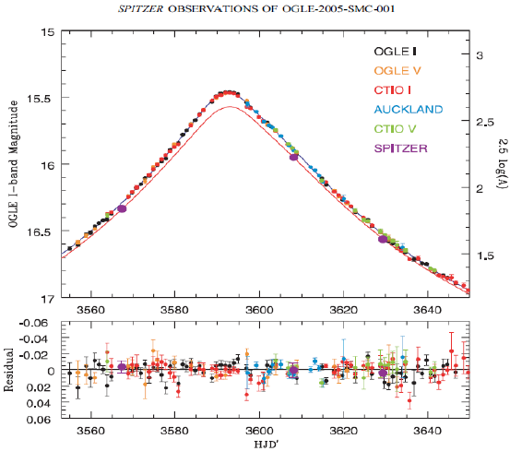
Earth-Satellite Parallax
Spitzer or Kepler
Dong et al. (2007) ApJ 664, 862

Slide 28
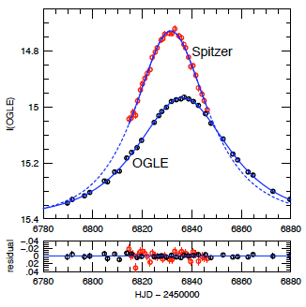
Spitzer: Single Star Lens
OGLE-2014-BLG-0939
2014 :100h pilot study
Weekly target upload.
Accurate mass and distance for 22 lenses
e.g:
OGLE-2014-BLG=0930
M=0.23+/-0.07 Msun
D=3.1+/-0.4 kpc
Yee et al. (2014) arXiv

Slide 29
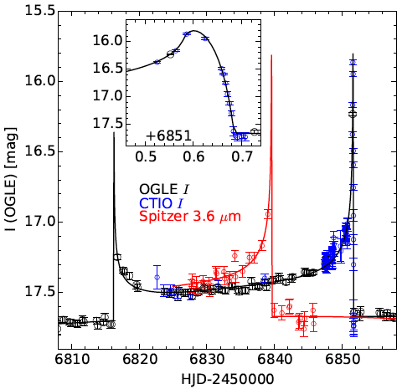
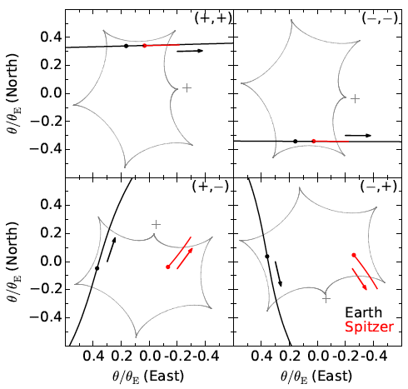
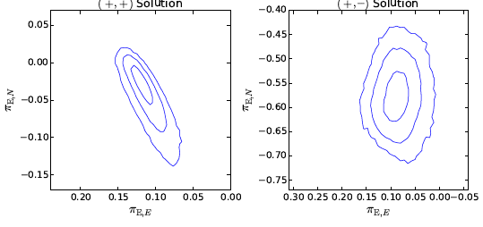
Spitzer: Binary Star Lens
OGLE-2014-BLG-1050
Zhu et al. (2015) arXiv

Slide 30
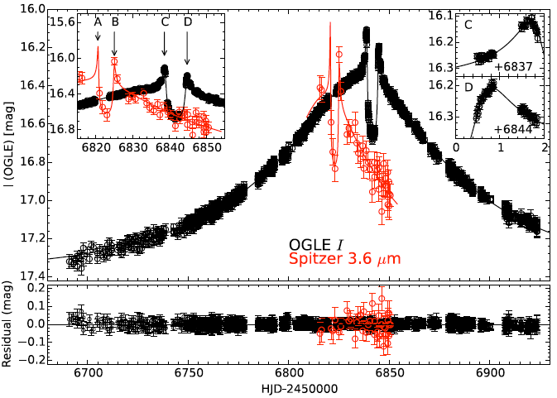
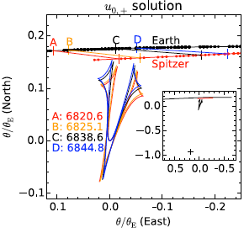
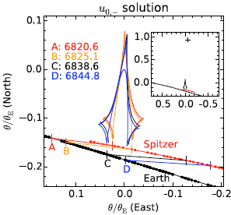
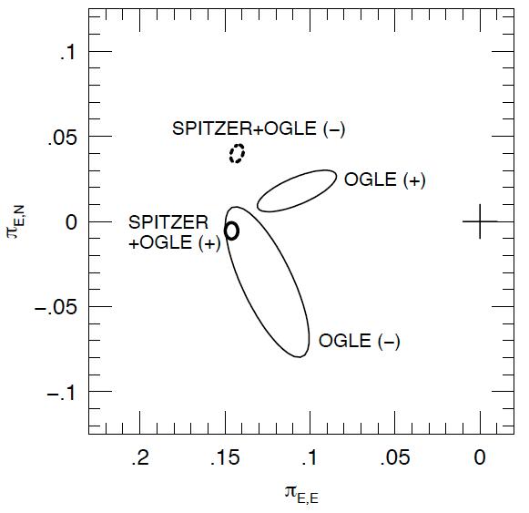
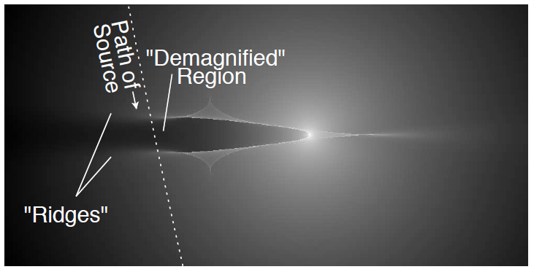
Spitzer : Star + Planet Lens
OGLE-2014-BLG-0124
Udalski et al. (2015) ApJ 799, 237.

Slide 31
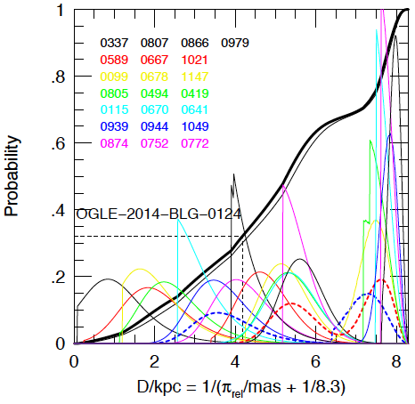
Spitzer : Galactic Dist’n of Cool Planets
2014 (100h) Pilot Study:
  1 Planet / 21 Stars
2015 (900h) + …
Planet Abundance
for Bulge vs Disk lenses
Calchi-Novati et al. (2015) ApJ

Slide 32
Microlensing with Kepler
Kepler’s 10ºx10º FoV can cover many microlens events in parallel.
Continuous lightcurves
30-min cadence – adequate.
4 arcsec pixels – adequate.
Microlens parallaxes (hence lens masses and distances) from the projected Kepler-Earth separation ( ~0.3 AU )
Independent planet survey Lighcurves from Kepler and Earth, probing for planets along different image trajectories, will see different planets.
2016
2015
2014
Earth
2015
2014

Slide 33
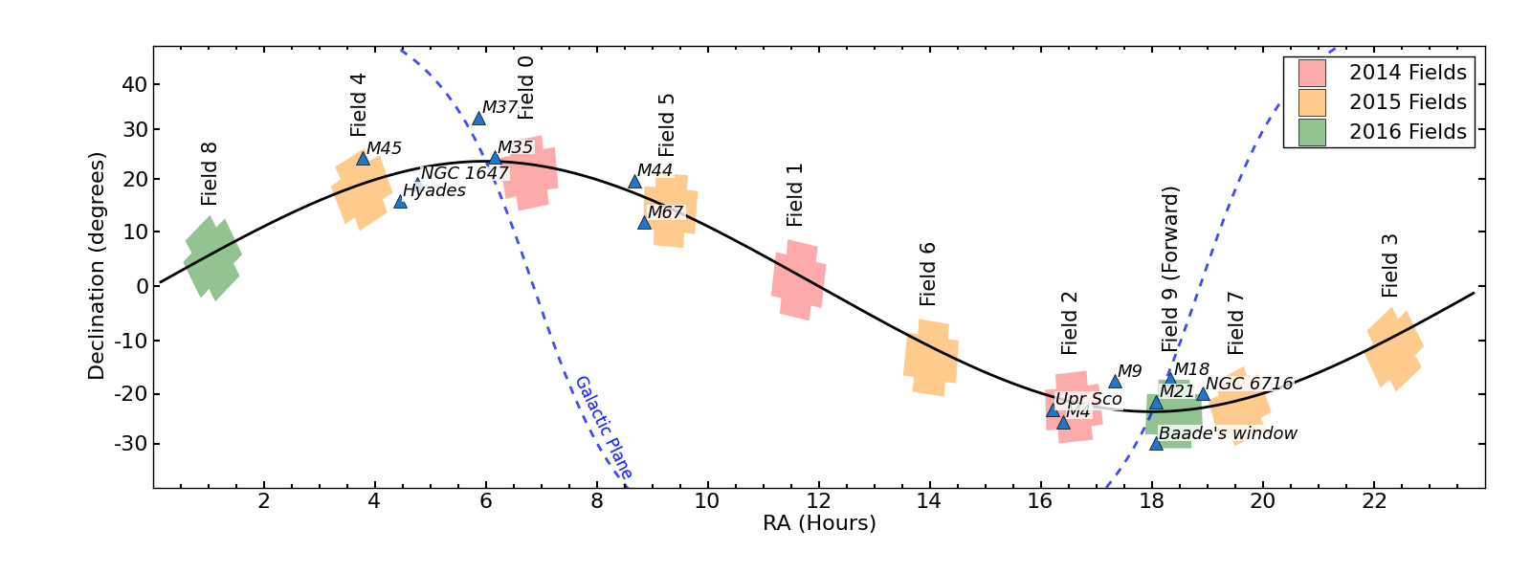
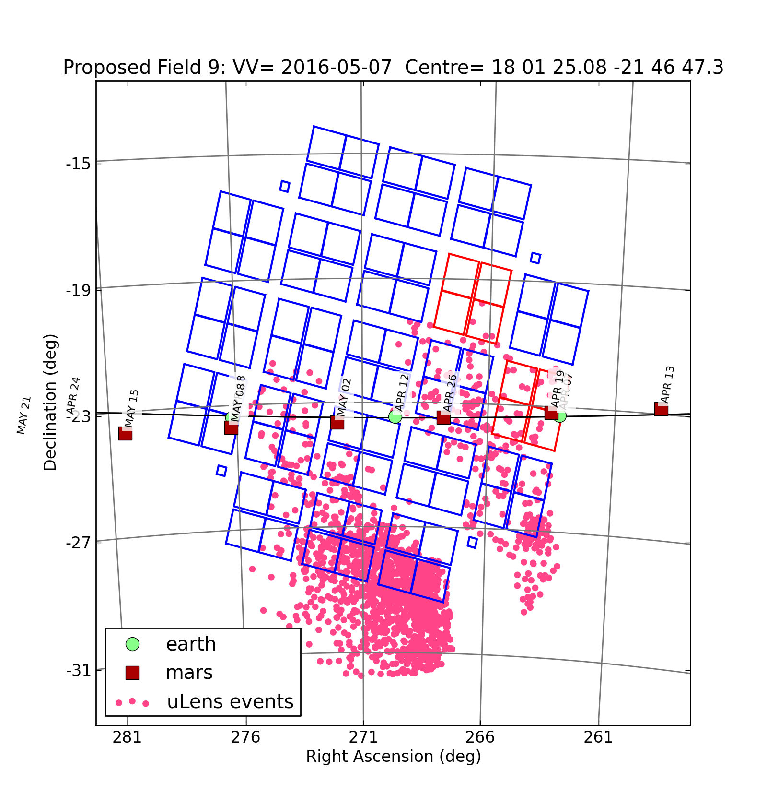
Kepler 2 Campaign 9 Spring 2016
2016 Apr 06 – Jun 29
30 min cadence
2 x 40-day campaigns
Pointing restricted – can’t center on best field.
Can’t upload new targets.
Can store/download only 5% of the FoV ~5 sq. deg

Slide 34
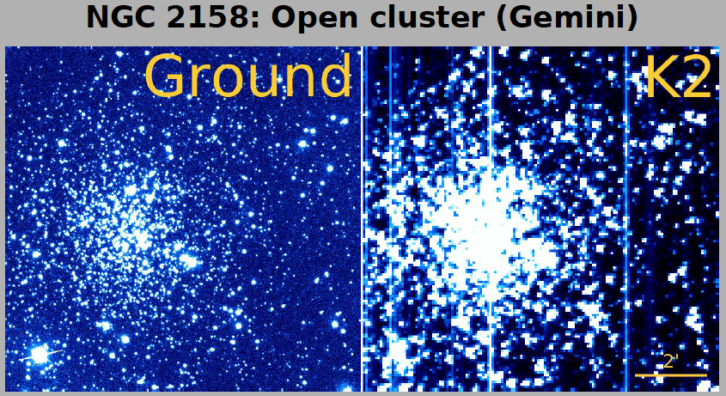
Kepler 4” pixels – DIA essential

Slide 35
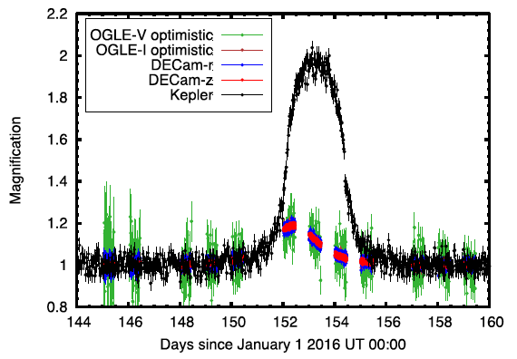
Anticipated Results from K2C9
Expect from K2C9 survey:
Masses/distances for all lenses.
~4 star + planet lenses
~15 “free-floating” planets
Galactic distribution of cool planets
Mass Function of FFPs
Saturn-mass “free-floating” planet
Simulation by Mathew Penny

Slide 36
Summary: Microlens Planet Surveys
Small cool planets (5-10/yr) outside the snow line
Currently: Power-law mass function
More telescopes -> more (and smaller) planets
  LCOGT (2014…), KMTNet (2015…)
Microlensing parallaxes -> accurate distances/masses
  Spitzer (2014 … ) Kepler (2016) WFIRST/Euclid (2023?)
  Galactic distribution of cool planets
  Mass function of the “free-floating” planets
Angular Resolution -> smaller mass planets
  WFIRST/EUCLID (2023…?)
  GravityCam (M.Dominik talk)

Slide 37
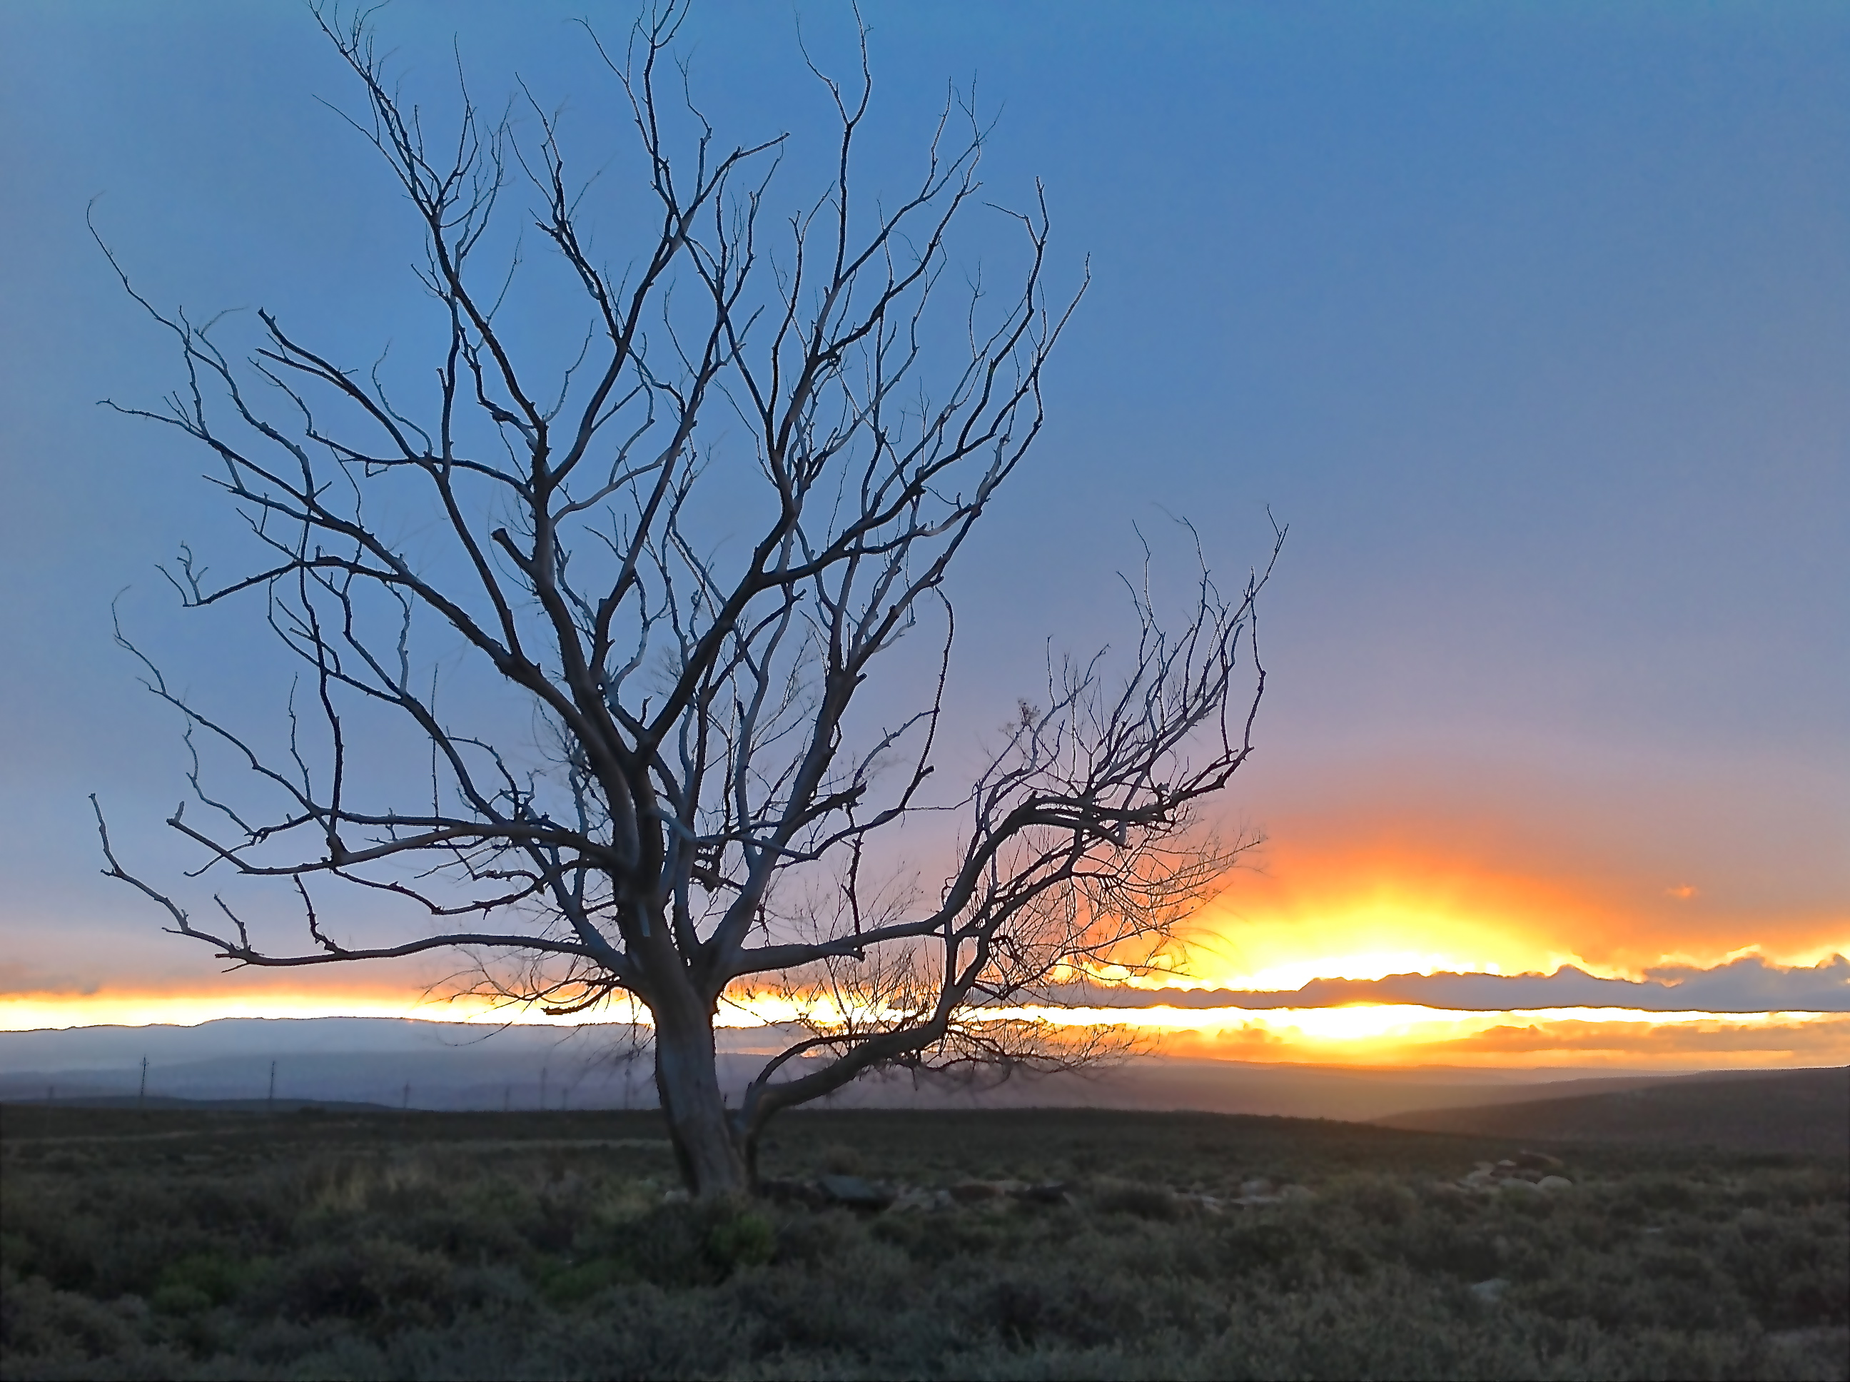
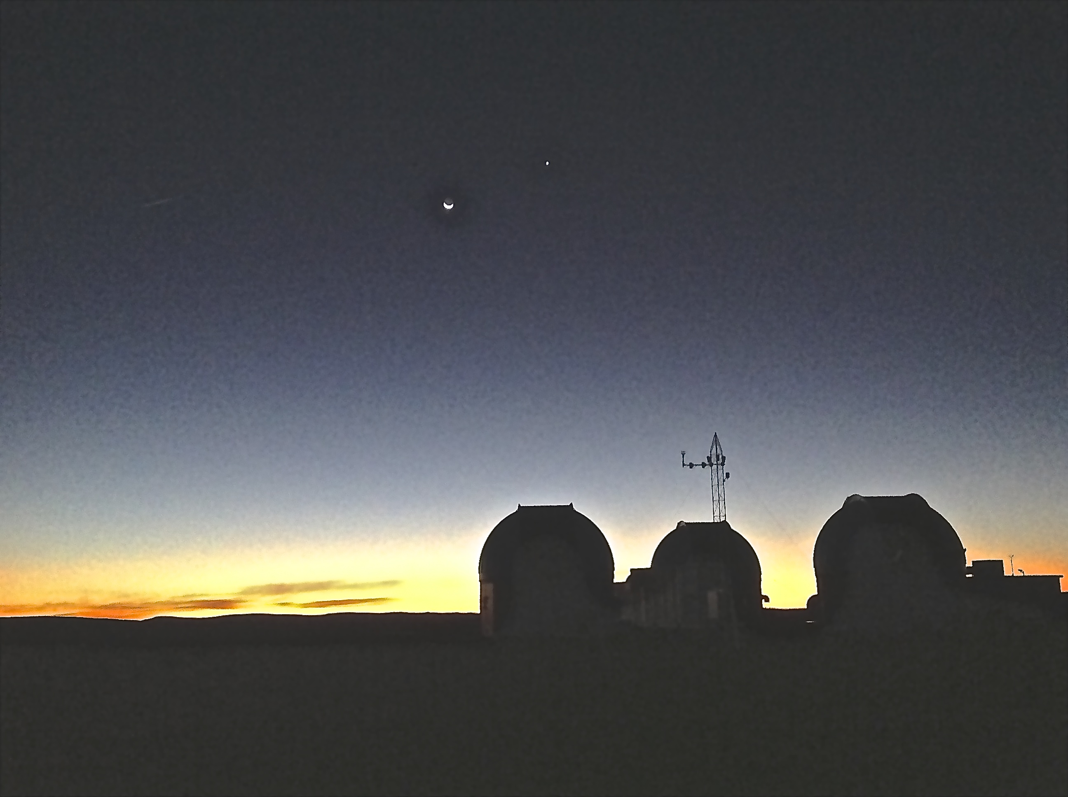
Thanks for listening …

